Slide 1
Introduction Series
Machine Learning Part 1

Slide 2




Volume, Velocity, Variety
1.2 Trillion Photos Were Taken in 2017
5 Billion Video’s Watched on YouTube Per Day
40 Million Tracks on Spotify, Growing at 20,000 Per Day

Slide 3


What is Machine Learning (ML)?
“Any sufficiently advanced technology is indistinguishable from magic.”
It is a method of data analysis that automates analytical model building. It is a branch of artificial intelligence based on the idea that systems can learn from data, identify patterns, and make decisions with minimal human intervention.
Tools and Technology That Enable Us to Answer Questions About Our Data
Arthur C. Clarke
Me

Slide 4
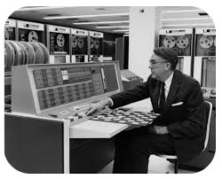
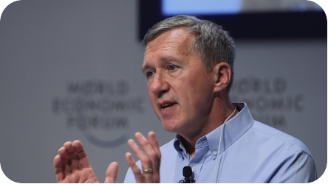
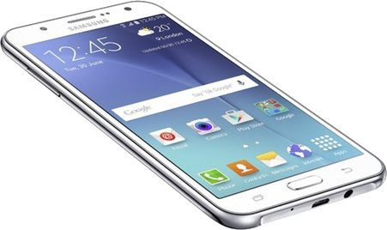
But What is the Right Definition?
1959
Tom Mitchell 1998
“A field of study that gives computers the ability to learn without being explicitly programmed.”
“A computer is said to learn from experience E with respect to some task T and some performance P, if its performance on T, as measured by P, improves with experience E..”
Arthur Samuel

Slide 5
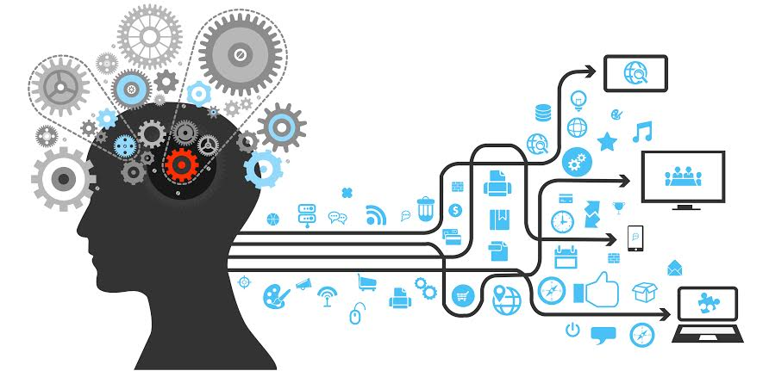
Machine Learning Since 1642
1642 – First Mechanical Calculator
1679 – Invention of Binary
1770 – Chess playing automaton wows Europe
1847 – George Boole invents Boolean Logic Algebra
1997 – IBM Deep Blue beats Gary Kasparov at Chess
1943 – Human neural network modelled in circuits
1959 – Neural network improves phone call quality
1979 – First autonomous vehicle, Stanford Cart
2006 – Deep Learning Invented
2012 – Google Brain teaches itself face recognition
2014 – Chatbot passes the Turing Test
2016 – Natural Language Processing

Slide 6
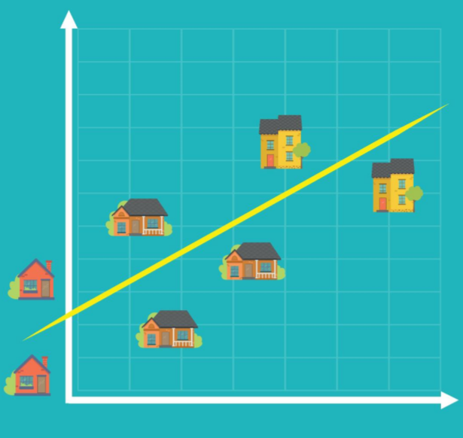
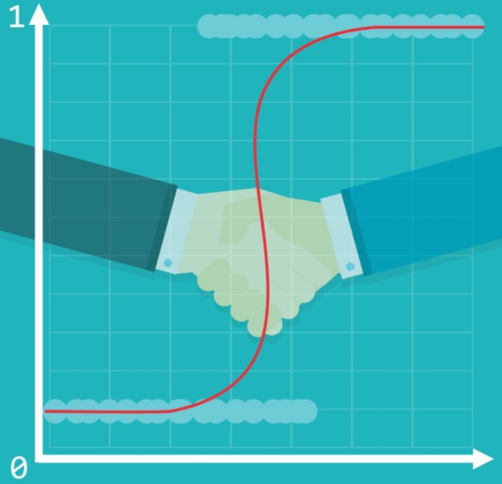
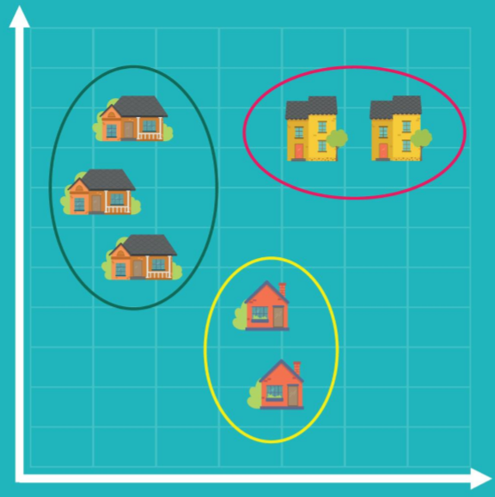
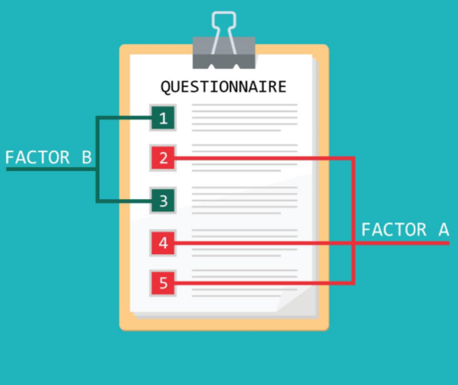
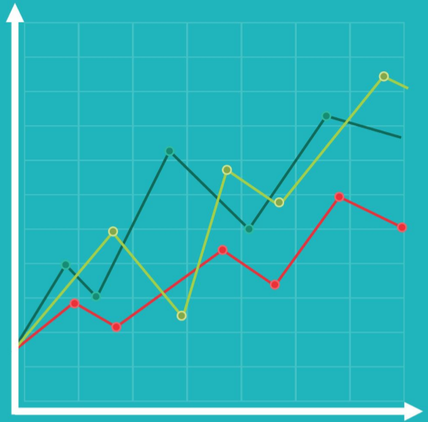
Traditional Approaches Some Overlaps with Machine Learning ….
Linear Regression
Logistic
Regression
Cluster Analysis
Factor Analysis
Time Series Analysis
Identifies the causal relationships amongst different variables
E.g. House price influenced by neighbourhood, house size, age, etc
Overcomes relationships that cannot be described linearly as 0 and 1
I.e. Filtering job candidates and how successful they will be in the first year (E..g > 50% success then 1 otherwise 0)
Exploratory approach where observations in the data form groups according to a categorisation
E.g. House price cost in-relation to size and location to a major centre (Downtown)
Like Cluster Analysis but focused on features rather than observations
E.g. if in a 100-item questionnaire every 10 questions pertains to a single attitude, factor analysis will identify the 10 factors. These can then be used for a regression, to provide a more interpretable prediction
Widely used in finance and economics, used for following values over time.
E.g. Tracking stock price changes over time, where time is presented horizontally

Slide 7
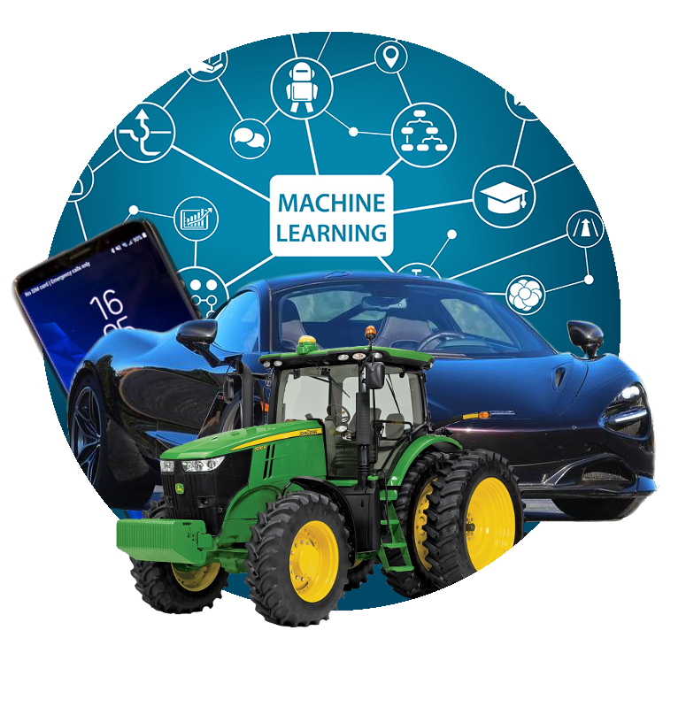
Machine Learning
State of the Art
Approach
The computer uses the algorithm to discover the model that finds what is being sought
An evolution over traditional approaches, as unlike before the Algorithm is at its core.
Human involvement is minimised, and in Deep-Learning the internals are often too complex

Slide 8
How Does It Work?
y = m * x + b
m¹
m & b are the only values available to train/adjust – no other way to affect the line
** There can be many lines **
m²
[
Weights
]
[
Biases
]
m^{1,1}
m^{2,1}
m^{3,1}
,
,
,
m^{1,2}
m^{2,2}
m^{3,2}
b^{1,1}
b^{2,1}
b^{3,1}
,
,
,
b^{1,2}
b^{2,2}
b^{3,2}

Slide 9

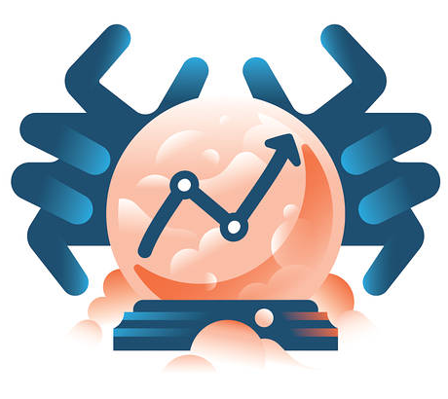
The Training Process
1
We use random values for W & B, making sure not to bias one state over another
2
We compare the output with what we expect it to have produced. We update W & B and Test again. As training progresses, M (the line) moves closer to identifying the correct separation between attributes
Training Data “Labelled Data”
[
Weights
]
[
Biases
]
m^{1,1}
m^{2,1}
m^{3,1}
m^{1,2}
m^{2,2}
m^{3,2}
b^{1,1}
b^{2,1}
b^{3,1}
b^{1,2}
b^{2,2}
b^{3,2}
,
,
,
,
,
,
3
Now we use Evaluation to see if the Model is any good. Use data that wasn’t used for training
Model
Prediction

Slide 10
Types of ML & Algorithms
Types
Supervised
Un-Supervised
Semi-Supervised
Reinforcement
As experts we act as the teacher, feeding the computer with training input “labelled” data and share the correct answer
Supervised learning algorithms try to model the relationships and dependencies between input features and target prediction
The computer is trained with unlabelled data
There is no teacher, the computer learns the patterns and is useful when there is no data expert
Algorithms focus on mining for rules, detecting patterns and summarising/grouping data points to derive meaning
Useful for when only some of the observed data has labels
These algorithms exploit the idea that even though group membership of unlabelled data is not known, the data includes important information about the group parameters
Similar to Supervised learning, where mapping is used between input and output, with this method the agent learns by trial and error using feedback from its own actions and experiences
Overview
Nearest Neighbour
Naïve Bayes
Decision Trees
Linear Regression
Support Vector Machine
Neural Networks
K-Means Clustering, Association Rules
Pseudo-Label
Ladder Networks
Q-Learning
Temporal Difference
Deep Adversarial Networks
Algorithms

Slide 11


Training

Slide 12
Demo

Slide 13
Trying out the Demo for Yourself
Install Python
Install Python Package Manager (PIP) Note: Starting Python 3.4, PIP is installed by default if you use the Python Installation binary
Install SciPy, Numpy, Matplotlib, Pandas and Sklearn with PIP
Download the Python code from the Brown Bag Website

Slide 14
Further Reading
Introduction
Crash Course: Introduction to Machine Learning by Google
Why Machine Learning Matters
Demonstrations
Machine Learning Used to Defeat PacMan
Reinforcement Learning Example of Playing Go
Book
Python Data Science Handbook

Slide 15
Thank you

